Slide 1
Accelerated pyramid
Making gsky faster
First status update on: 22 Aug, 2019
Latest status update on: 19-Sep-19

Slide 2
purpose
To be able to view at continent zoom levels.
Faster displays.
To be used with other WMS clients.
QGIS, ArcGIS, Google Earth and NASA WorldWind.
KMLs that call the PNGs or GSKY are to be generated.
To The Demo…

Slide 3
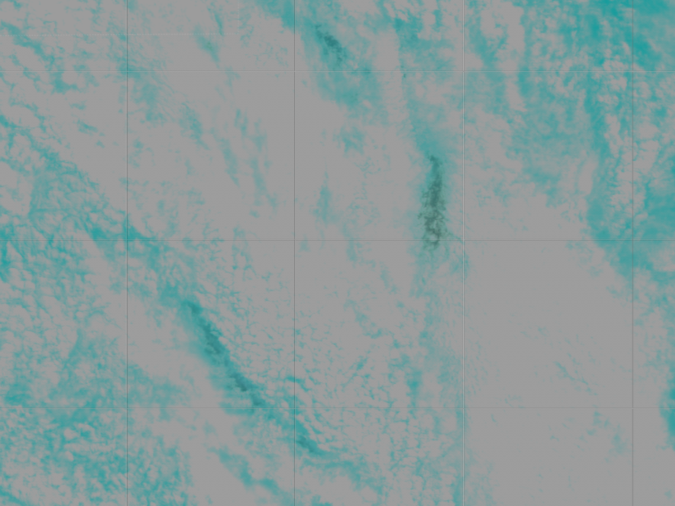
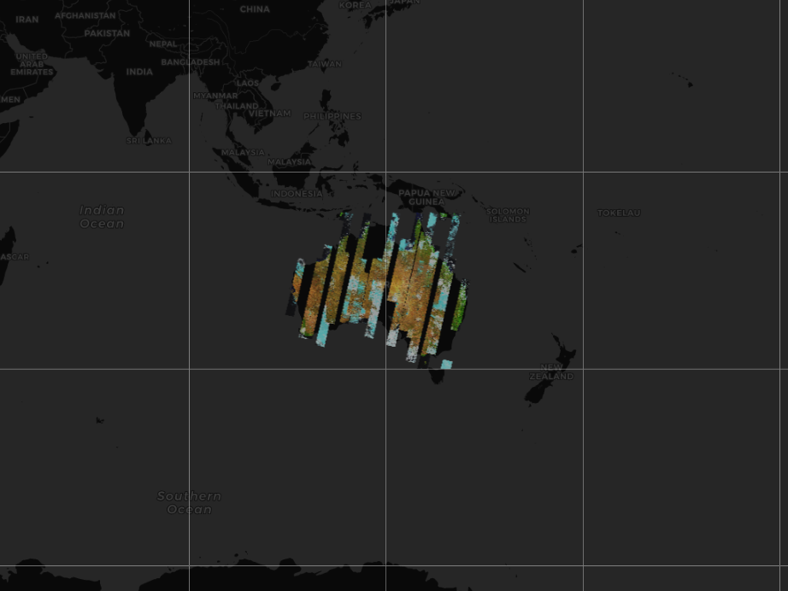
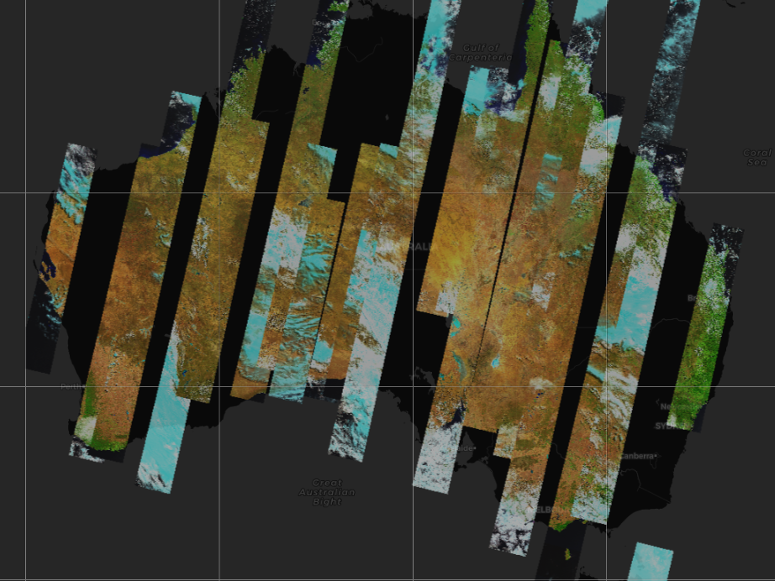
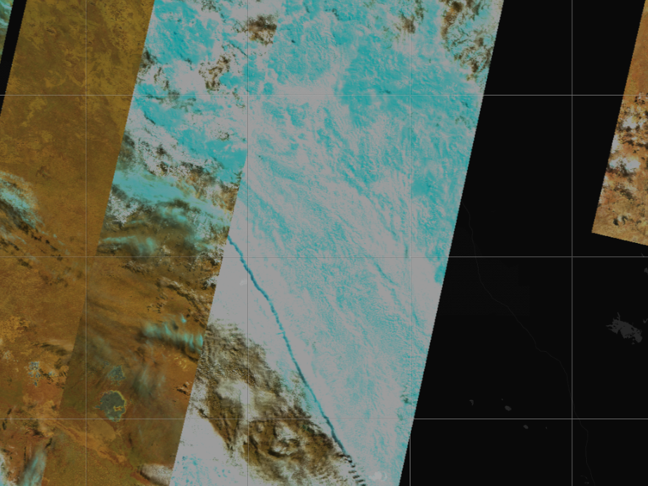
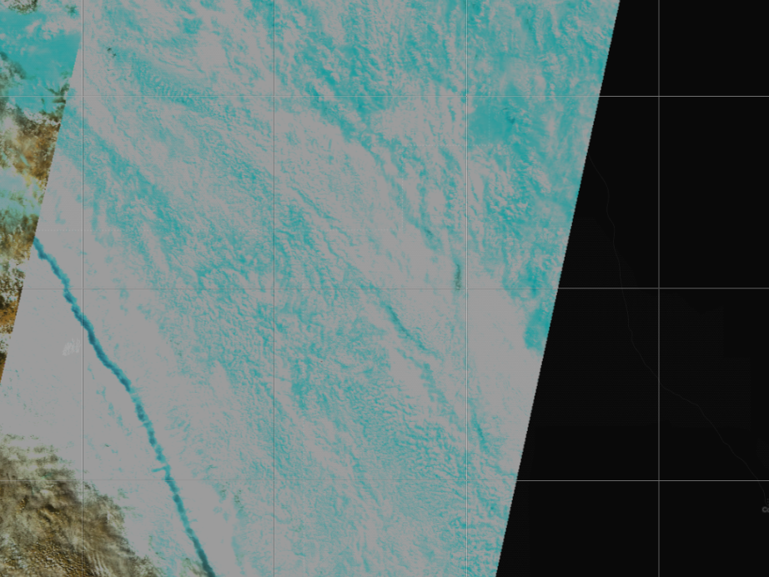
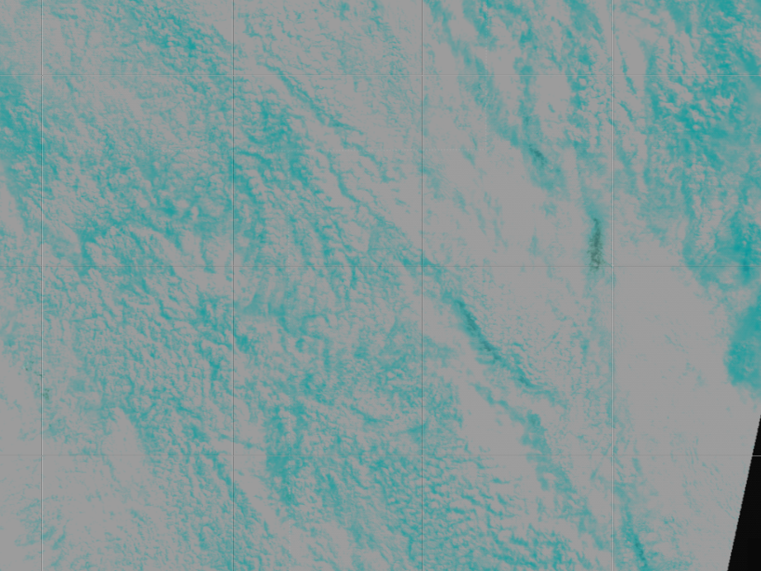
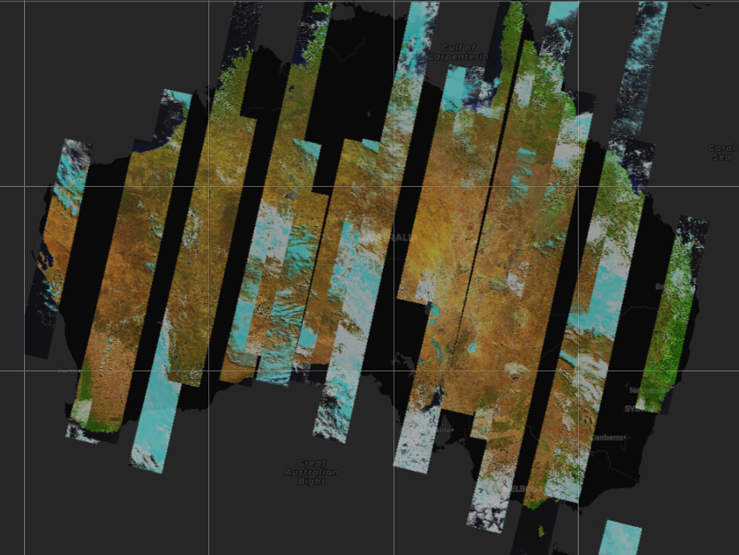
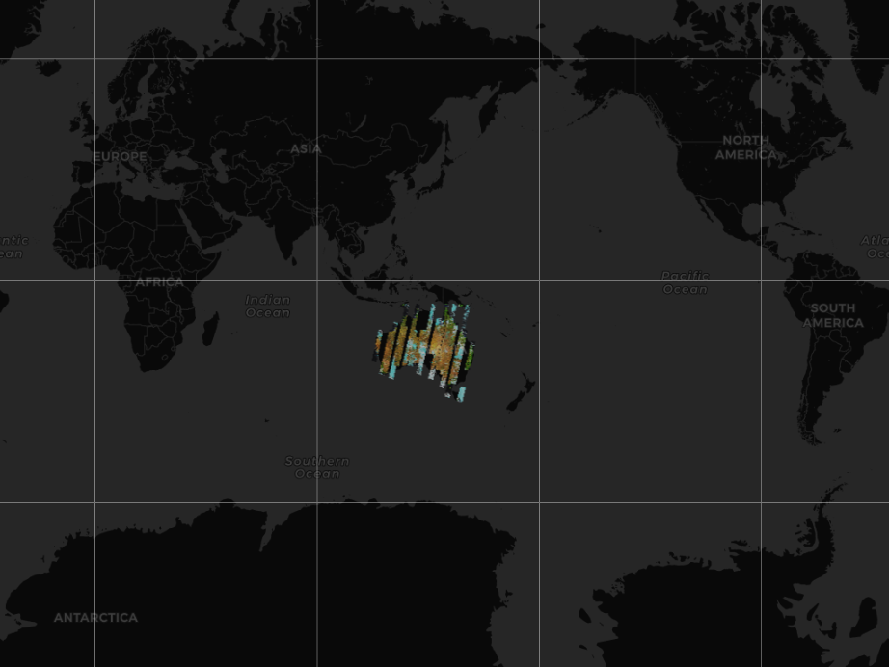
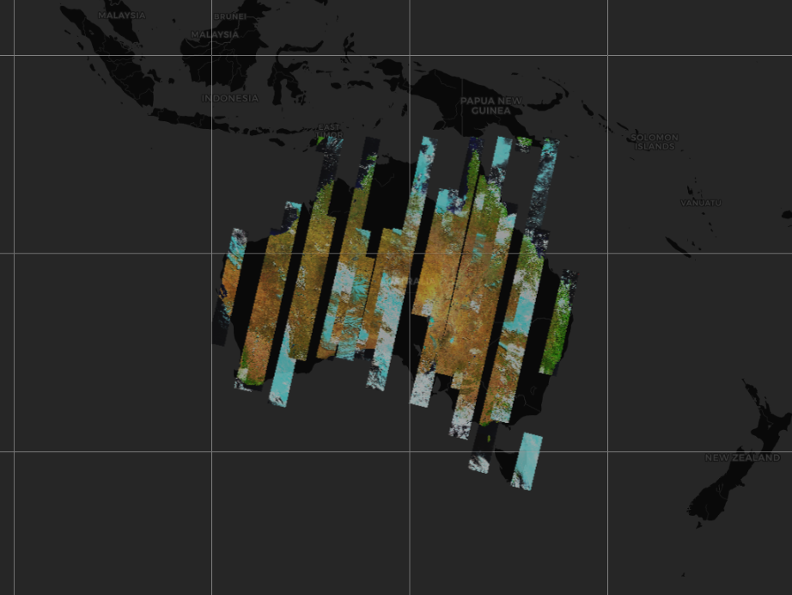
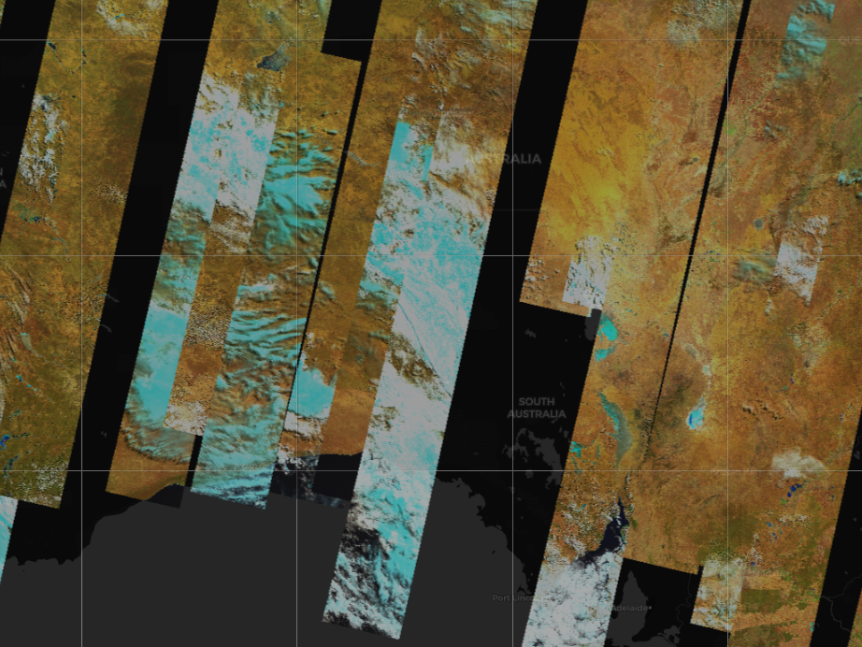
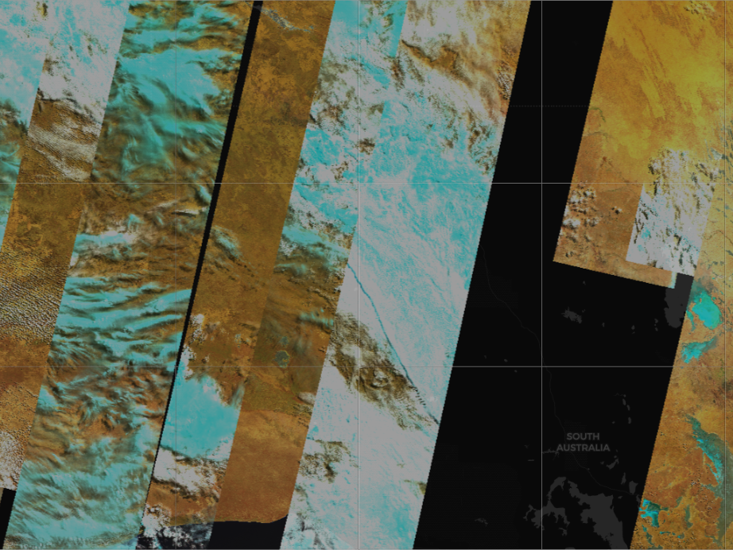
16-day DEA Landsat 8 surface reflectance – 19/03/2013
View this as a slide show.
Click mouse to animate.

Slide 4
limitations
Only suitable for Terria and other WMS clients.
ArcGIS and QGIS are to be tested.
These require continent level display.
Not suitable for scripts.
Non-standard bounding boxes.
Too many tiles to cache.
Excessive processing time and storage space.

Slide 5
solution
Cache only the building blocks.
Create the tiles for a high zoom level alone (say, 10 km)
Create a tile on the fly.
Concatenate 4 images and resize to form the next lower zoom level.
16 for next, 64 for the one after and so on.
This will cater for all zoom levels in Terria.
Crop smaller tiles from a larger one.
This will cater for the non-standard bounding boxes in scripts.

Slide 6
challenges
Must work for scripts and all WMS clients.
Creation of tiles on the fly should not take too long.
Conversion of coordinates from EPSG:4326 to EPSG:3857
Scripts send as EPSG:4326, whereas Terria sends as EPSG:3857.
Now using external Python scripts for the conversion.
Must investigate GO functions for it.
There are some minor disparities during the conversion.

Slide 7
Logic and algorithm
Change the GSKY server code to reconstruct a tile.
Determine the enclosing bbox from the incoming bbox values.
Find or create a tile for the enclosing bounding box.
Calculate the offsets of the smaller tile.
Crop from the larger tile, re-page and re-size to the small tile.
Logic was tested manually and it works.
The algorithm is nearly completed.
To The Demo…

Slide 8
The way to build large and subset tiles from small building blocks
Build the 10km zoom level tiles for a layer and time slice. (6,254 tiles; 665M)
Use ImageMagick to build a 20km tile as follows.
1
2
1. convert 1.png 2.png +append 1-2.png
2. convert 3.png 4.png +append 3-4.png
3
4
3. convert 1-2.png 3-4.png -append 1234.png
3. Crop an area to make small tiles
convert 1234.png -crop 256x256+128+128 +repage 5.png
4. Resize a smaller tile to 256x256
convert 1234.png -crop 128x128+192+192 +repage 6.png
convert 6.png -resize 256x256 7.png
See next slide for examples. View it as a slide show.

Slide 9
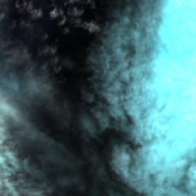
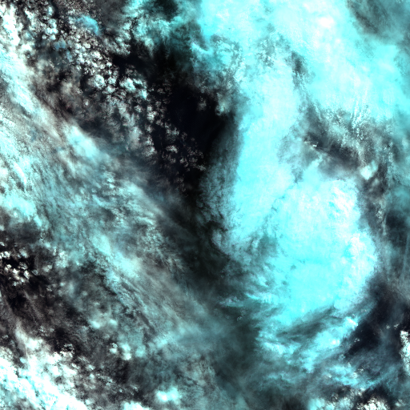
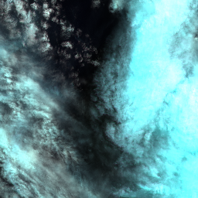


Manually created tiles to develop the logic. Must view this slide as a slide show.
128x128 cutout Resized
512x512 Actual size; Created from 4 x 10km tiles
256x256 cutout. Actual size
20km tile from 4 x 10km tiles.
128x128 cutout. Actual size
Notes:
Test

Slide 10
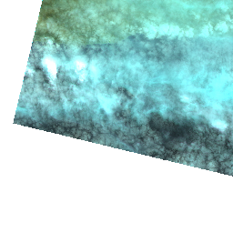


Created by the GSKY code.
Must view as a slide show.
Enclosing tile (cached or compiled from building blocks)
Resized to fit the dimensions in the call
Still to do:
Calculate the offsets to create tiles
Handle both EPSG:3857 and EPSG:4326
Requested BBOX (Not cached)

Slide 11
Update on 5 Sep, 2019
Implemented an algorithm to build tiles on the fly.
Using three cached levels: 10, 100, 500
Two lower levels created from the cached tiles.
Documented the steps and code so far.
Zoom levels vs. time to paint a page:
3000 km - 11 sec
1000 - 7 sec
500 - 1 sec - Cached
300 - 38 sec
200 - 15 sec
100 - 1 sec - Cached
50 - 66 sec
20 - 13 sec
10 - 1 sec – Cached
Cached levels are taken directly.
In between levels are built from the cached levels.
Built tiles take 500 milliseconds.
Cached tiles take 500 microseconds.
Total page takes higher…
Browser latency
CPU overload
Next: Dynamic Caching

Slide 12
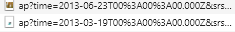
Dynamic Caching
Built tiles are saved in temp directory.
Re-display takes 1 second for whole page.
The cache is emptied at midnight.
Further enhancements
Better parallelization to cache.
Shift display to GRPC worker nodes.
Optimise the calls from Terria.
Eliminate the second date.
Next: Cropping the tiles

Slide 13
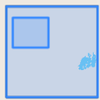
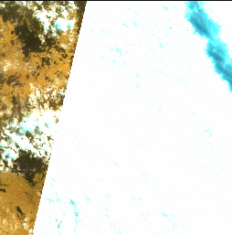
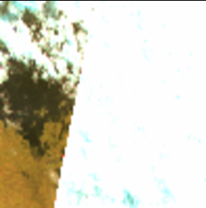
Cropping to display for scripts
Non-standard bounding boxes from scripts.
EPSG:4326 coordinates.
Converts to EPSG:3857
Works for subsets of 10km levels.
Must crop from composite tiles.
Still to do. Code is ready.
Subset
10 km tile
Note: It is cropping the wrong area.
- Must fix.
- Offsets are to be taken from top left.

Slide 14
Further work and Challenges
Shift the tile building to worker nodes.
Bring the total page display down to milliseconds.
Eliminate Terria’s second date fetching.
Heuristic algorithm.
Impractical.
Build tiles on Raijin.
Needs benchmarking of KSUs.

Slide 15
Update on 20 Sep, 2019
PoC: using cached PNG tiles for all zoom levels: Working.
Continent-wide display.
Fast painting of screen.
Works with Terria and, probably, other WMS clients.
ArcGIS, QGIS
These require continent-wide display.
KMLs to zoom in.
Will not work with scripts.
PoC: Modification to work with scripts: Working.
Non-standard BBOX.
EPSG:4326 to EPSG:3857.
Composite or cropped tiles.
PoC: Replacing PNG with TIFF: Not yet working.
Crawling issues.
Storage space.
Caching time.
Next: TIFF method: Details

Slide 16
Replacing PNG with TIFF
Use GeoTIFFs instead of PNGs as cached tiles.
Crawl these into MAS.
GSKY will now build PNGs from these TIFFs.
It might be faster than building from NetCDFs.
Advantages
No change in GSKY core code.
Caching time may be lower.
Storage space could be lower.
Will eliminate ImageMagick, an external program.
Requirements
WCS method to save as GeoTIFFs.
Crawling into MAS.
A separate ‘config.json’ with new layer names.
Potential Issues
TIFFs may use more storage space and/or caching time.
Crawling into MAS won’t be automatic.
TIFFs do not save the time stamps.
Next: TIFF method: Findings

Slide 17
Findings
This method is still not working…
The TIFFs must be crawled into the MAS database.
Crawling gives errors
band 1: SetOffset() not supported on this raster band
No timestamps in the TSV file.
Solutions
Ignore the first error
Manually insert the time stamps into the TSV
Storage space is another issue.
Total of 72 files for one time slice/zoom level
Size: 23 GB
cf. 1 GB as PNGs.
It could take 359 TB for all time slices.
cf. 2 TB for PNGs after skipping the blank tiles.
Blanks probably cannot be skipped in TIFFs.
Crawling and Ingestion...
Trying to ingest into a local MAS database.
Having trouble with PostgreSQL on my VM.
Still investigating…
Next: TIFF vs. PNG comparison

Slide 18
Comparison of PNG vs. TIFFs
 | TIFFs | PNGs (tiles on the fly) | PNGs (cached)
New code in GSKY | No | Major changes | Minor changes
External program | No | Image Magick | No
GRPC cluster | Yes | Yes (not yet done) | Yes (not yet done)
Speed of display | Unknown | Slow to fast¹ | Very fast
Storage space | High (360 TB) | Low (2 TB) | Low (2 TB)
Caching time | 8 KSUs ² | 22 KSUs | 22 KSUs
Parallelisation | No³ | Yes | Yes
New Config | Yes | No (setting in config) | No (setting in config)
Updates in MAS | Manual⁴ | Auto; No MAS update | Auto; No MAS update
Dynamic Caching | No | Yes | Not Applicable
1. Slow to build on the fly. Fast after dynamic caching.
2. Sequential alone is possible: 35 min per time slice.
3. Times out in parallel execution. Needs investigation.
4. Inserting time stamps; may be automated. Ingesting into MAS database.

